Slide 1
- The Secret Formula - Presentation Menu -
Secret Formula
For Kids
Secret Formula
Presentation
Secret Formula
Family Version
Secret Formula
For Educators

Slide 2
Be the best that you can be!
Dedicated to all kids. Be kind! Be generous! Be courageous!
By Diane Diaz Gomez Ph.D.

Slide 3
The Secret Formula
Designed to enhance communication between the generations. Whole book approach.
Current research shows that half of kids today, have an adult that they can confide in.
More kids today, struggle with anxiety, depression and loneliness.
This session will show you helpful tools that you can use to help kids succeed and be the best that they can be!

Slide 4
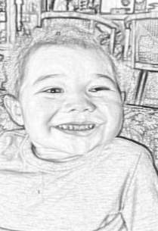
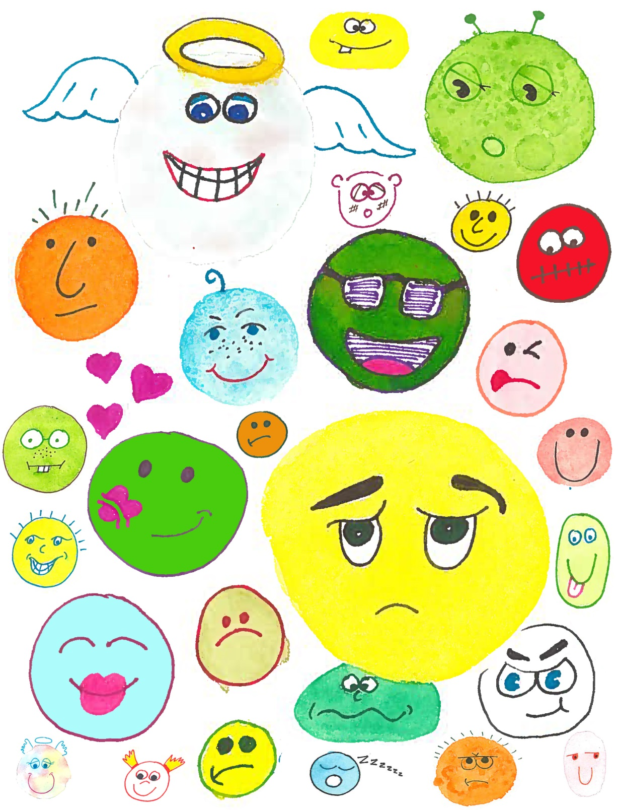
There are more than 3, 000 feelings in the English language. When asked to list emotions, we can usually list around 10. It is important to identify how we are feeling, because our feelings, our thoughts and behaviors are all related.
Notes:
Play feeling game. Have them write as many feeling words as possible and then use scatter gory concept

Slide 5
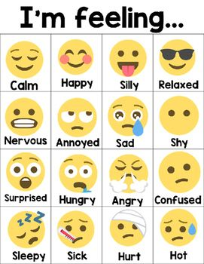
How are you feeling today?

Slide 6
Kids today, experience a range of emotions.
Frustration- taking tests at school
Afraid- to tell parents how they are doing academically
Lonely- feeling left out and excluded
Angry- kids talking about them
Disappointed- in themselves
Sadness- do not see mom or dad
Anxious- family problems at home
Happy- because they have friends who support them
Some kids have difficulty at home and at school and are overwhelmed with emotions.
Notes:
Play feelings game (Scattegories)

Slide 7
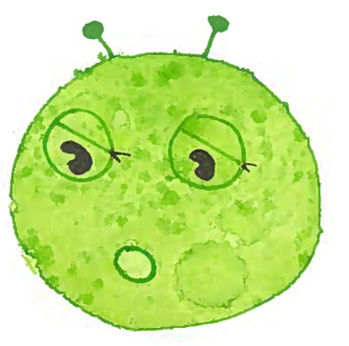
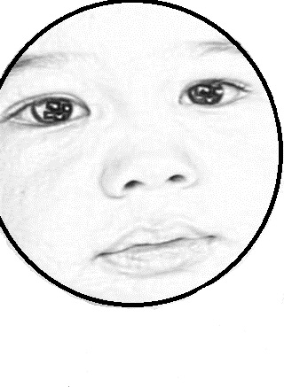
Sometimes it is hard to know how we are feeling. Sometimes, we are happy, mad or sad. Sometimes all at once!
Unexpressed emotions will never die. They are buried alive and will come forth later in uglier ways.
Sigmund Freud
Notes:
Read New York times article

Slide 8
Life is a battle. Love yourselves.
Put on an armor, because life can be a battle. But first, we need to love ourselves, amore so we can love others. Love is the positive energy that will inspire us to be the best that we can be.
We need help to strengthen our minds, our hearts and our bodies to be the best that we can be.
If we are going to reach our full potential we have to be a warrior! Be a Victor, not a victim. Be a Warrior not a worrier.
Who is your hero? Why?
Notes:
Think of the Olympics. Did anyone watch?
Snowboarding/figure skating were amazing.
Consistent training, hours and years to be the best that they can be

Slide 9
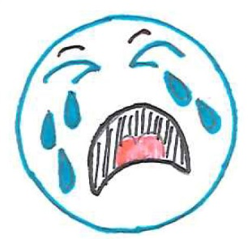
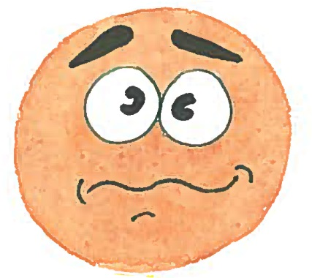
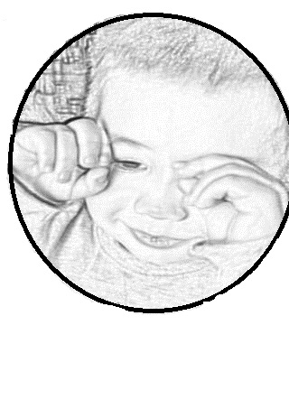
Our thoughts, our feelings, and our behaviors are all connected.
Watch your thoughts, they become words. Watch your words, they become actions. Watch your actions, they become habits. Watch your habits, they become character. Watch your character, for it becomes your destiny. (Anonymous)
“True test of a persons character is what you do when no one is watching.”
John Wooden
Notes:
Your gifts may take you to a certain level, but if you do not have the character to match them. You will not stay there. Nothing may be happening on the outside, but if you keep the right attitude, something is happening on the inside.

Slide 10
Our brains have it in for us!
We produce up to 50,000 thoughts a day and up to 40,000 of them are negative.
Normal part of human behavior. Be warned- the mind makes things up!
You do not have to believe your negative thoughts. Your mind is just one part of you: it is not you!
The SF teaches us to focus on positive thoughts and actions to produce positive energy and enjoy a healthier and happier lifestyle.

Slide 11
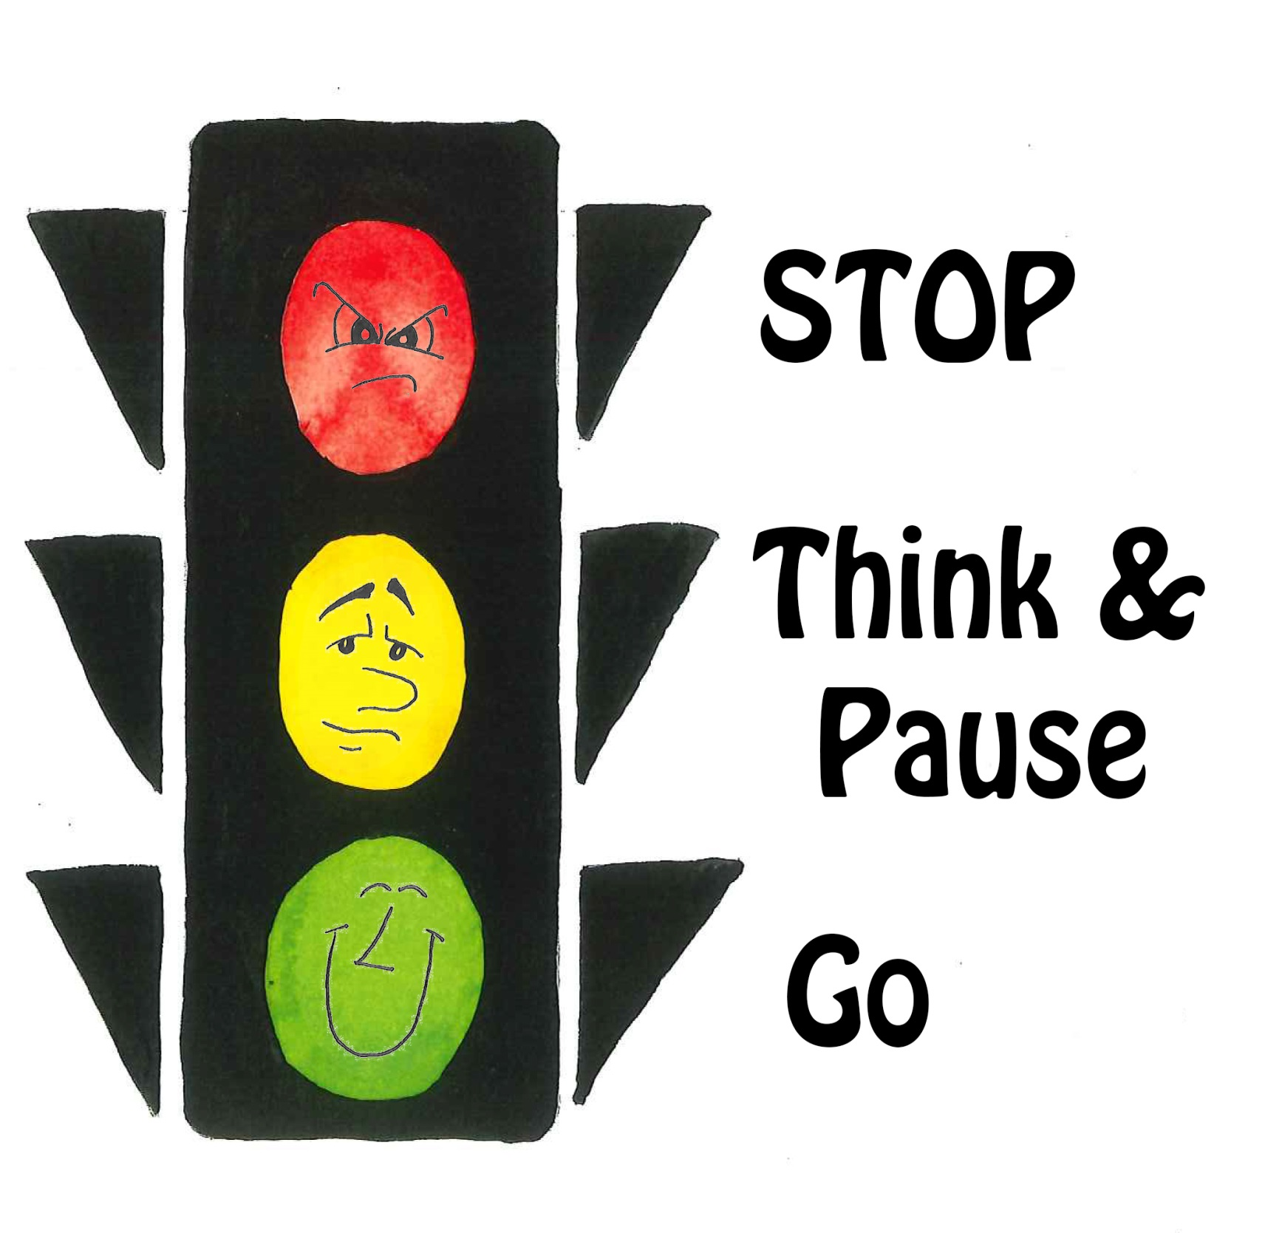
One tool to use to gauge our thoughts is STOP, PAUSE, THINK & GO!
Think of a traffic signal. Sometimes when we are mad or sad, we have to STOP ourselves! What is going on? How am I feeling? Is it positive or negative energy?

Slide 12
All of your thoughts and perceptions are filtered through your unique belief system. They are just thoughts. If you want fewer of them, stop giving them power. Change the thought. P.S. The thought probably wasn’t true anyway!
When a feeling is uncomfortable, we make efforts to avoid it. But when we register and identify the feeling, we can move on easier. THINK it through! When we change our thinking, our behavior changes too, and so does the atmosphere. “If you do not like what you are thinking, think of something else!”
Notes:
Blessing of that person. Reinforcement is anything that maintains behavior.

Slide 13
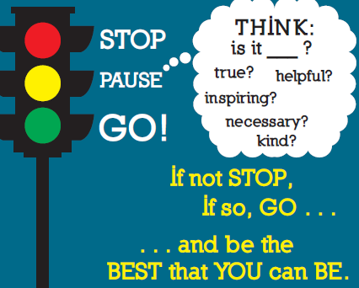
THINK before we say something or do something.
When we have GO Behaviors that is a signal to keep going! You will feel better and you will attract positive energy and make better decisions. Focus on the present moment. Become aware of what is happening, in you and around you, when it happens. Be mindful.
Notes:
Mind-

Slide 14
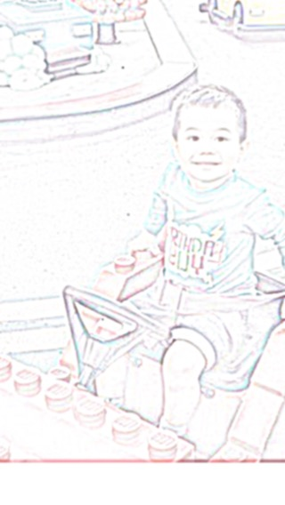
The yellow light reminds us to
PAUSE and THINK!
PAUSE means to take some deep breaths and use the five senses (seeing, smelling, touching, tasting and hearing) to help make better decisions. How does my body feel? What emotions am I feeling? Focus on your breath. Breathe slowly, in and out, until you are able to become calm and present in the moment. Choose to be mindful not mindless.
Notes:
Do hand activity-using senses breathing meditations,k fake yawning

Slide 15
Draw an outline of your hand below. Using the five senses, write down what brings you comfort! (sight, smell, touch, taste, sound)

Slide 16
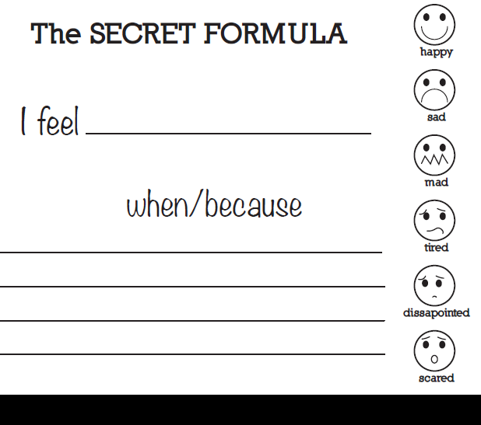
Sometimes we need to let someone know how we are feeling on the inside. Talk to a trusted friend or adult. Use the SF to express yourself.
The secret to the SF is, “Do not use the word you!”
How do you feel today? Practice using the SF to describe how you feel.
Play the FEELING CUBE GAME on the back page!

Slide 17
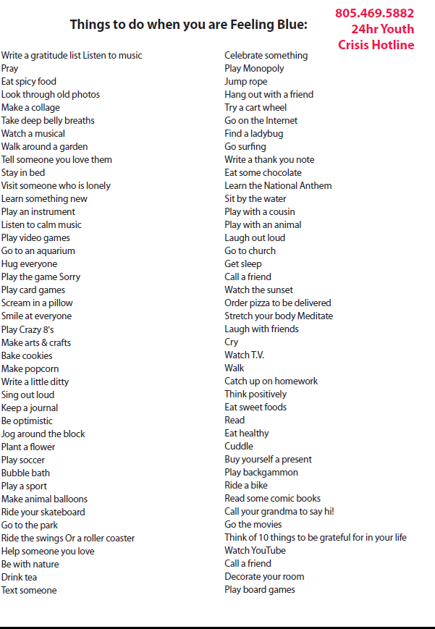
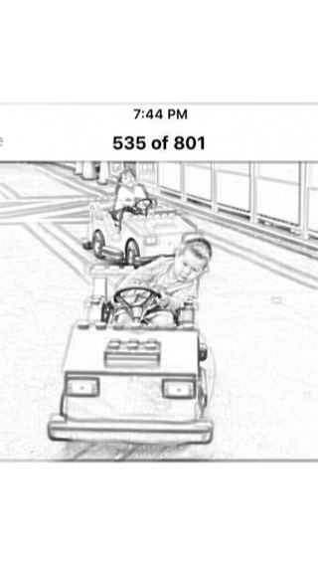
Sometimes when we feel mad or sad, we need to change our mind and have some fun instead. When we spend time doing things that make us feel happy, we become happy.
Take a ride!
Circle things that you like to do for fun. Do something fun today.
Notes:
To reduce negative energy from anger, sadness and anxiety we need to use a variety of physical activity, CBT and nutrition. Cover book. Get out in nature!

Slide 18
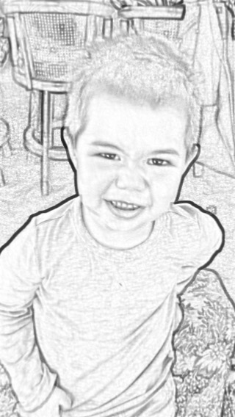
The power of a mantra!
Having a mantra that you repeat to yourself over and over also helps you to be the best that you can be. Just make sure it is a positive message! Think positive and become positive.
“Be careful what you THINK, because your thoughts run your life.” (Whatever you choose to think, your mind takes it seriously and your actions will reflect your thinking)
Do you have a mantra? What is it?
Think of things you are grateful for in your life. What 5 things are you grateful for today?
Do something kind for someone. When we help someone, we are really helping ourselves. What act of kindness can you do today?

Slide 19
People with goals succeed because they know where they are going.
Believe and succeed.
We become what we think about.
No one cares how much you know, until they know how much you care.
A person is what he or she thinks about all day long
- Ralph Waldo Emerson
“We can alter our lives by altering the attitudes of the mind.” William James
If you think in negative terms you will get negative results. If you think in positive terms, you will achieve positive results.

Slide 20
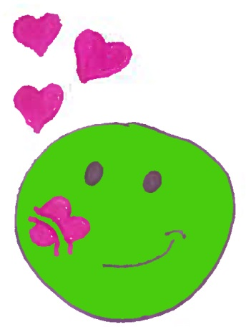
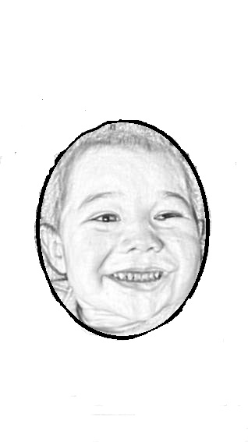
Something else that you can do to be the best that you can be, is to sing a little ditty to yourself.
A little ditty is a little song that you can sing to help you feel better about yourself.
What is your favorite song? Can you take a few lines of the song and make it into a little ditty?
“Let it go,
Let it go,
Let it GO!”
Be the best that you can be! Add this line to the end of your little ditty too.
Notes:
Or stop pause think and go1

Slide 21
Set some goals for yourself! A goal is something that you want to make happen, happen!
Think about some things that you like to do? What is something you are good at doing? Take a few minutes and make a list of your passions. Write everything down—anything that excites you, anything that energizes you. What is something that will help you to become the best that you can be?
What two things can you do today?
1.
2.
What would be on your bucket list?
Do two things everyday that will help you be the best that you can be!
Bucket list-something you want to do once in your future.
Notes:
185,000 hours working.

Slide 22
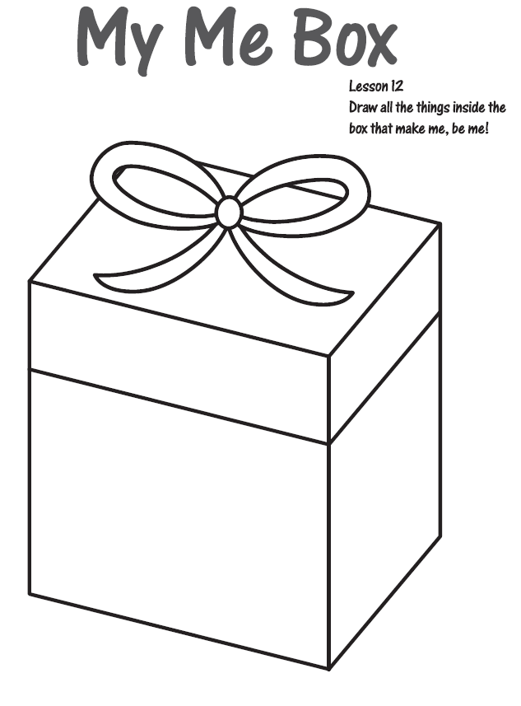
Sometimes it is not easy to be the best that we can be, and that is okay. No one is perfect. We are all different and unique and that is what makes me be me and you be you! Everyday is a new day to be the best that we can be and the best time to be the very best that we can be, is in the present moment. Be true to yourself and love yourself! You are a gift.
My Me Box

Slide 23
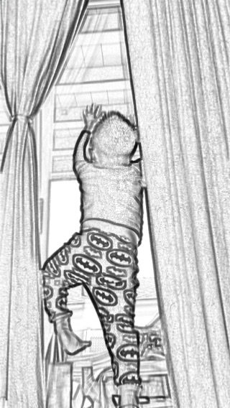
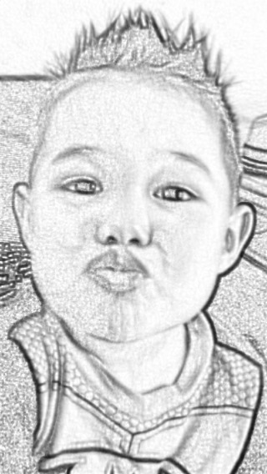
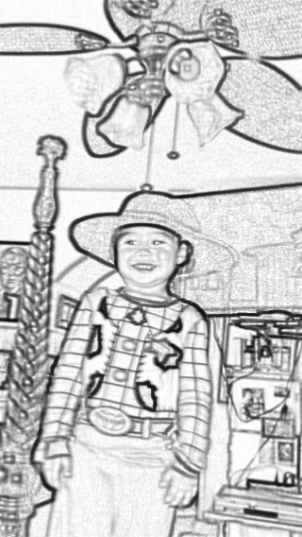
Sometimes we will make mistakes (oopsie) and that is okay. Learn from them. Do not repeat them. Forgive yourself and forgive others. Do something kind for someone, and you will feel better about yourself, too. You have the power to change your negative thoughts to positive thoughts and fill your life with positive actions.
Let’s do this!

Slide 24
What are some things that can help me to be the best that I can be?
If you do not like what you are thinking, think of something else. Use positive thinking to attract positive energy.
Problem solving- Use the THINK model-. Is it true, helpful, inspiring, necessary , kind?
If not STOP, if so GO! Be the best that you can be!
Express inside feelings with someone you trust, using the Secret Formula. sentence frame. Remember the secret to the Secret Formula? Do not use the word, YOU!
PAUSE-Take some deep belly breaths. Look at your hand profile to see what comforts you.
Have some fun from the things to do list!
Think of 5 things that you are grateful for at this moment.
Recite your mantra, over and over.
Sing your little ditty- Let it go, shake it off, Stop, Pause, Think and GO (3x’s). End with be the best that you can be!
Goals- do two things today to help your life flow.
Play the feeling cube game.
Do something kind for someone.

Slide 25
Tips for parents & caregivers
5 step communication
Give assertive directive-“Short and sweet”- go to bed, pick up toys, finish homework, play with your toys on the floor, finish your food, keep your hands and feet to yourself. (Teach them what you want them to do, not what you don’t want them to do.)
Broken record-repeat directive over and over until done.
Physical guidance- gently, put your hand on their shoulder to guide them to finish the task. Show the child what you expect.
Use win-win! Finish your food, and then you can have dessert. Finish your homework, and then you can watch TV. Make your bed, and then you can play outside. (You win, and they win) Avoid the “If you don’t do this, you won’t do that!)
Catch them being good. Reinforce (Pay attention) to the desired behavior. Ignore to extinguish minor irritations. Compliment their GO! Behavior.
To redirect behavior-use the following:
Tell the child to STOP! (Avoid using the word No!, it comes back to haunt you!)
PAUSE- Ask them to take some deep breaths. (Take some too!)
USE the THINK process - Ask them, “Is what you are saying or doing, true, helpful, inspiring, necessary or kind?) If not STOP, if so GO! Be the best that you can be!
How to listen- be nonjudgmental, give undivided attention, listen carefully, focusing on facts and feelings. Allow time for reflection. Make sure consequences are simple/clear/enforceable/reasonable.

Slide 26
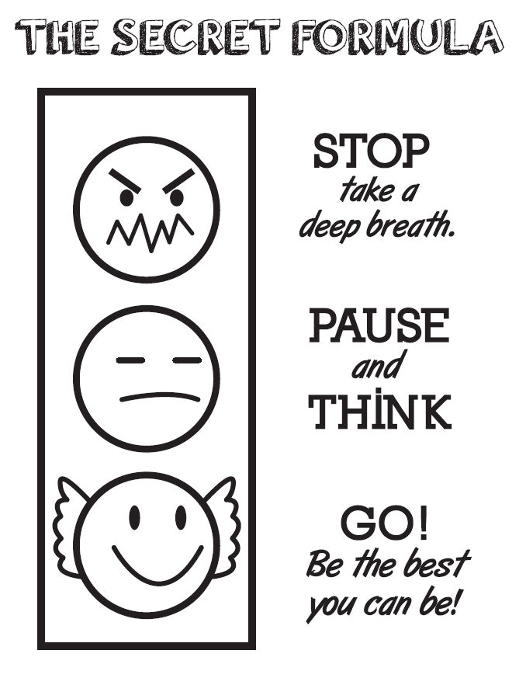

Slide 27
FREE Lessons available at dianediazgomezphd.com

Slide 28
My Gratitude Journal
Draw or write what you are grateful for today.

Slide 29
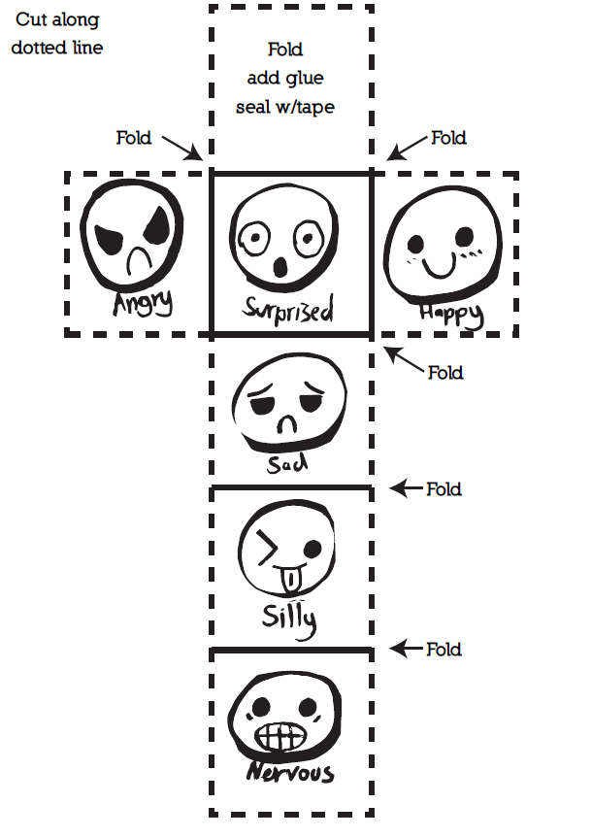
The Feeling
Cube Game
Make the feeling cube and toss it in the air.
Use the Secret Formula* to say what makes you feel that way and why!
* I feel _________ when /because ________.

Slide 30
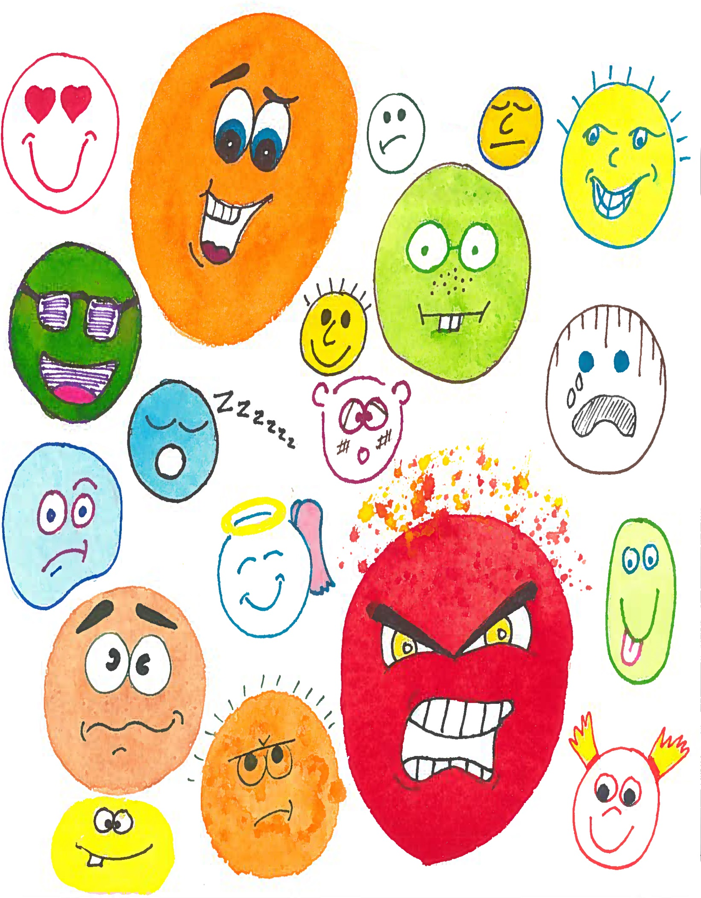
Be yourself. Love yourself. Who we become is more important then what we do or what we will have.

Slide 32
Be the best that you can be!
Dedicated to Cruz & Everest
- What you believe will become true for you!
Thank you, to my sister Carmen Makarewicz and Heidi Haines who suggested that the Secret Formula be modified for younger kids. And to my colleagues, Edgar Reyes for all his technological support and my grammar guru Stacie Tomes-Lopez.

Slide 33
This is a book about feelings.
Everyone has feelings!

Slide 34
Sometimes it is hard to know how we are feeling.
Sometimes we are happy, mad, or sad. Sometimes we are all of those at once!

Slide 35
There are a lot of different feelings, but all feelings stem from love or fear.
Love based feelings have positive energy, and fear based feelings have negative energy. Choose love feelings and attract positive energy so you can be the best that you can be. Love is kind. Be kind to yourself and to others.

Slide 36
Our thoughts, our feelings, and our behaviors are all connected.
What we think determines how we feel which determines what we do!!

Slide 37
Think of a traffic signal. Sometimes when we are mad or sad, we have to STOP ourselves! What is going on? How am I feeling? Is it positive or negative energy?

Slide 38
The yellow light reminds us to
PAUSE and THINK!
PAUSE means to take some deep breaths and use the five senses (seeing, smelling, touching, tasting and hearing) to help make better decisions. How does my body feel? What emotions am I feeling?
Focus on your breath. Breathe slowly, in and out, until you are able to become calm and present in the moment. Choose to be mindful not mindless.

Slide 39
Draw an outline of your hand below. Using the five senses, write down what brings you comfort! (sight, smell, touch, taste, sound)

Slide 40
THINK before we say something or do something.
When we have GO Behaviors, that is a signal to keep going! You will feel better, attract positive energy, and make better decisions. Focus on the present moment. Become aware of what is happening, in you and around you, when it happens. Be mindful.

Slide 41
Sometimes we need to let someone know how we are feeling on the inside. Talk to a trusted friend or adult. Use the SF to express yourself.
The secret to the SF is “Do not use the word you!”
How do you feel today? Practice using the SF to describe how you feel.
Play the FEELING CUBE GAME on the back page!

Slide 42
Sometimes when we feel mad or sad, we need to change our mind and have some fun instead. When we spend time doing things that make us feel happy, we become happy.
Take a ride!
Circle things that you like to do for fun. Do something fun today.

Slide 43
The power of a mantra!
Having a mantra that you repeat to yourself over and over also helps you
to be the best that you can be. Just make sure it is a positive message!
Think positive and become positive.
“Be careful what you
THINK, because your
thoughts run your life.”
(Whatever you choose to think, your mind takes it seriously and your actions will reflect your thinking)
Do you have a mantra? What is it?
Think of things you are grateful for in your life. What 5 things are you grateful for today?
Do something kind for someone. When we help someone, we are really helping ourselves. What act of kindness can you do today?

Slide 44
Something else that you can do to be the best that you can be is to sing a little ditty to yourself.
A little ditty is a little song that you can sing to help you feel better
about yourself.
What is your favorite song? Can you take a few lines of the song and make it into a little ditty?
“Let it go, Let it go, Let it GO!”
Be the best that you can be! Add this line to the end of your little ditty too.

Slide 45
Set some goals for yourself! A goal is something that you want to make happen!
Think about some things that you like to do. What is something you are good at doing? What is something that will help you to become the best that you can be?
Do two things everyday that will help you be the best that you can be!
What two things can you do today?
1.
2.
Bucket list-something you want to do once in your future.
What would be on your bucket list?
Here are some examples of a bucket list:
Skydiving, traveling to a far away country, inventing something, etc…

Slide 46
My Me Box
Sometimes it is not easy to be the best that we can be, and that is okay. No one is perfect. We are all different and unique, and that is what makes me be me, and you be you! Everyday is a new day to be the best that we can be. The best time to be the very best that we can be, is in the present moment. Be yourself; love yourself! You are a gift.

Slide 47
Let’s do
this!
Sometimes we will make mistakes (oopsie), and that is okay. Learn from them. Do not repeat them. Forgive yourself and forgive others. Do something kind for someone, and you will feel better about yourself, too. You have the power to change your negative thoughts to positive thoughts and fill your life with positive actions.

Slide 48
My Hero

Slide 49
What are some things that can help me to be the best that I can be?
If you do not like what you are thinking, think of something else. Use positive thinking to attract positive energy.
Problem solving - Use the THINK model. Is it true, helpful, inspiring,
necessary, or kind? If not, STOP; if so, GO! Be the best that you can be!
Express inside feelings with someone you trust. Use the Secret Formula sentence frame. Remember the secret to the Secret Formula? Do not use the word, YOU!
PAUSE – Take some deep belly breaths. Look at your hand profile to see
what comforts you.
Have some fun from the things on your to do list!
Think of 5 things that you are grateful for at this moment. Recite your mantra over and over.
Sing your little ditty – “Let it go, shake it off. Stop, Pause, Think and GO!”
(3x’s). End with “Be the best that you can be!”
Goals - do two things today to help your life flow. Play the feeling cube game.
Do something kind for someone.

Slide 50
Tips for Parents & Caregivers
5 Step Communication:
Give assertive directives that are “short and sweet”- “go to bed,” “pick up toys,” “finish homework,” “play with your toys on the floor,” “finish your food,” “keep your hands and feet to yourself.” (Teach them what you want them to do, not what you don’t want them to do.)
Be a broken record - repeat the directive over and over until it’s done.
Use physical guidance - gently put your hand on your child’s shoulder to guide them to finish the task. Show the child what you expect.
Use win-win! “Finish your food, and then you can have dessert.” “Finish your homework, and then you can watch TV.” “Make your bed, and then you can play outside.” (In other words, you win, and they win.) Avoid the “If you don’t do this, you won’t do that!”
Catch them being good. Reinforce (Pay attention!) to the desired behavior. Ignore minor irritations to extinguish them. Compliment your child’s GO! behavior.
To redirect behavior, use the following:
TELL the child to STOP! (Avoid using the word No! It comes back to haunt you!)
PAUSE - Ask them to take some deep breaths. (Take some too!)
USE the THINK process - Ask them, “Is what you are saying or doing, true, helpful, inspiring, necessary or kind?) If not STOP; if so GO! Be the best that you can be!
LISTEN - be nonjudgmental, give undivided attention, listen carefully, and focus on facts and feelings. Allow time for reflection. Make sure consequences are simple/clear/enforceable/reasonable.

Slide 52
FREE Lessons available at
dianediazgomezphd.com

Slide 53
My Gratitude Journal
Draw or write what you are grateful for today.

Slide 54
The Feeling Cube Game
Make the feeling cube and toss it in the air.
Use the Secret Formula* to say what makes you feel that way and why!
* I feel when /because .

